Slide 1
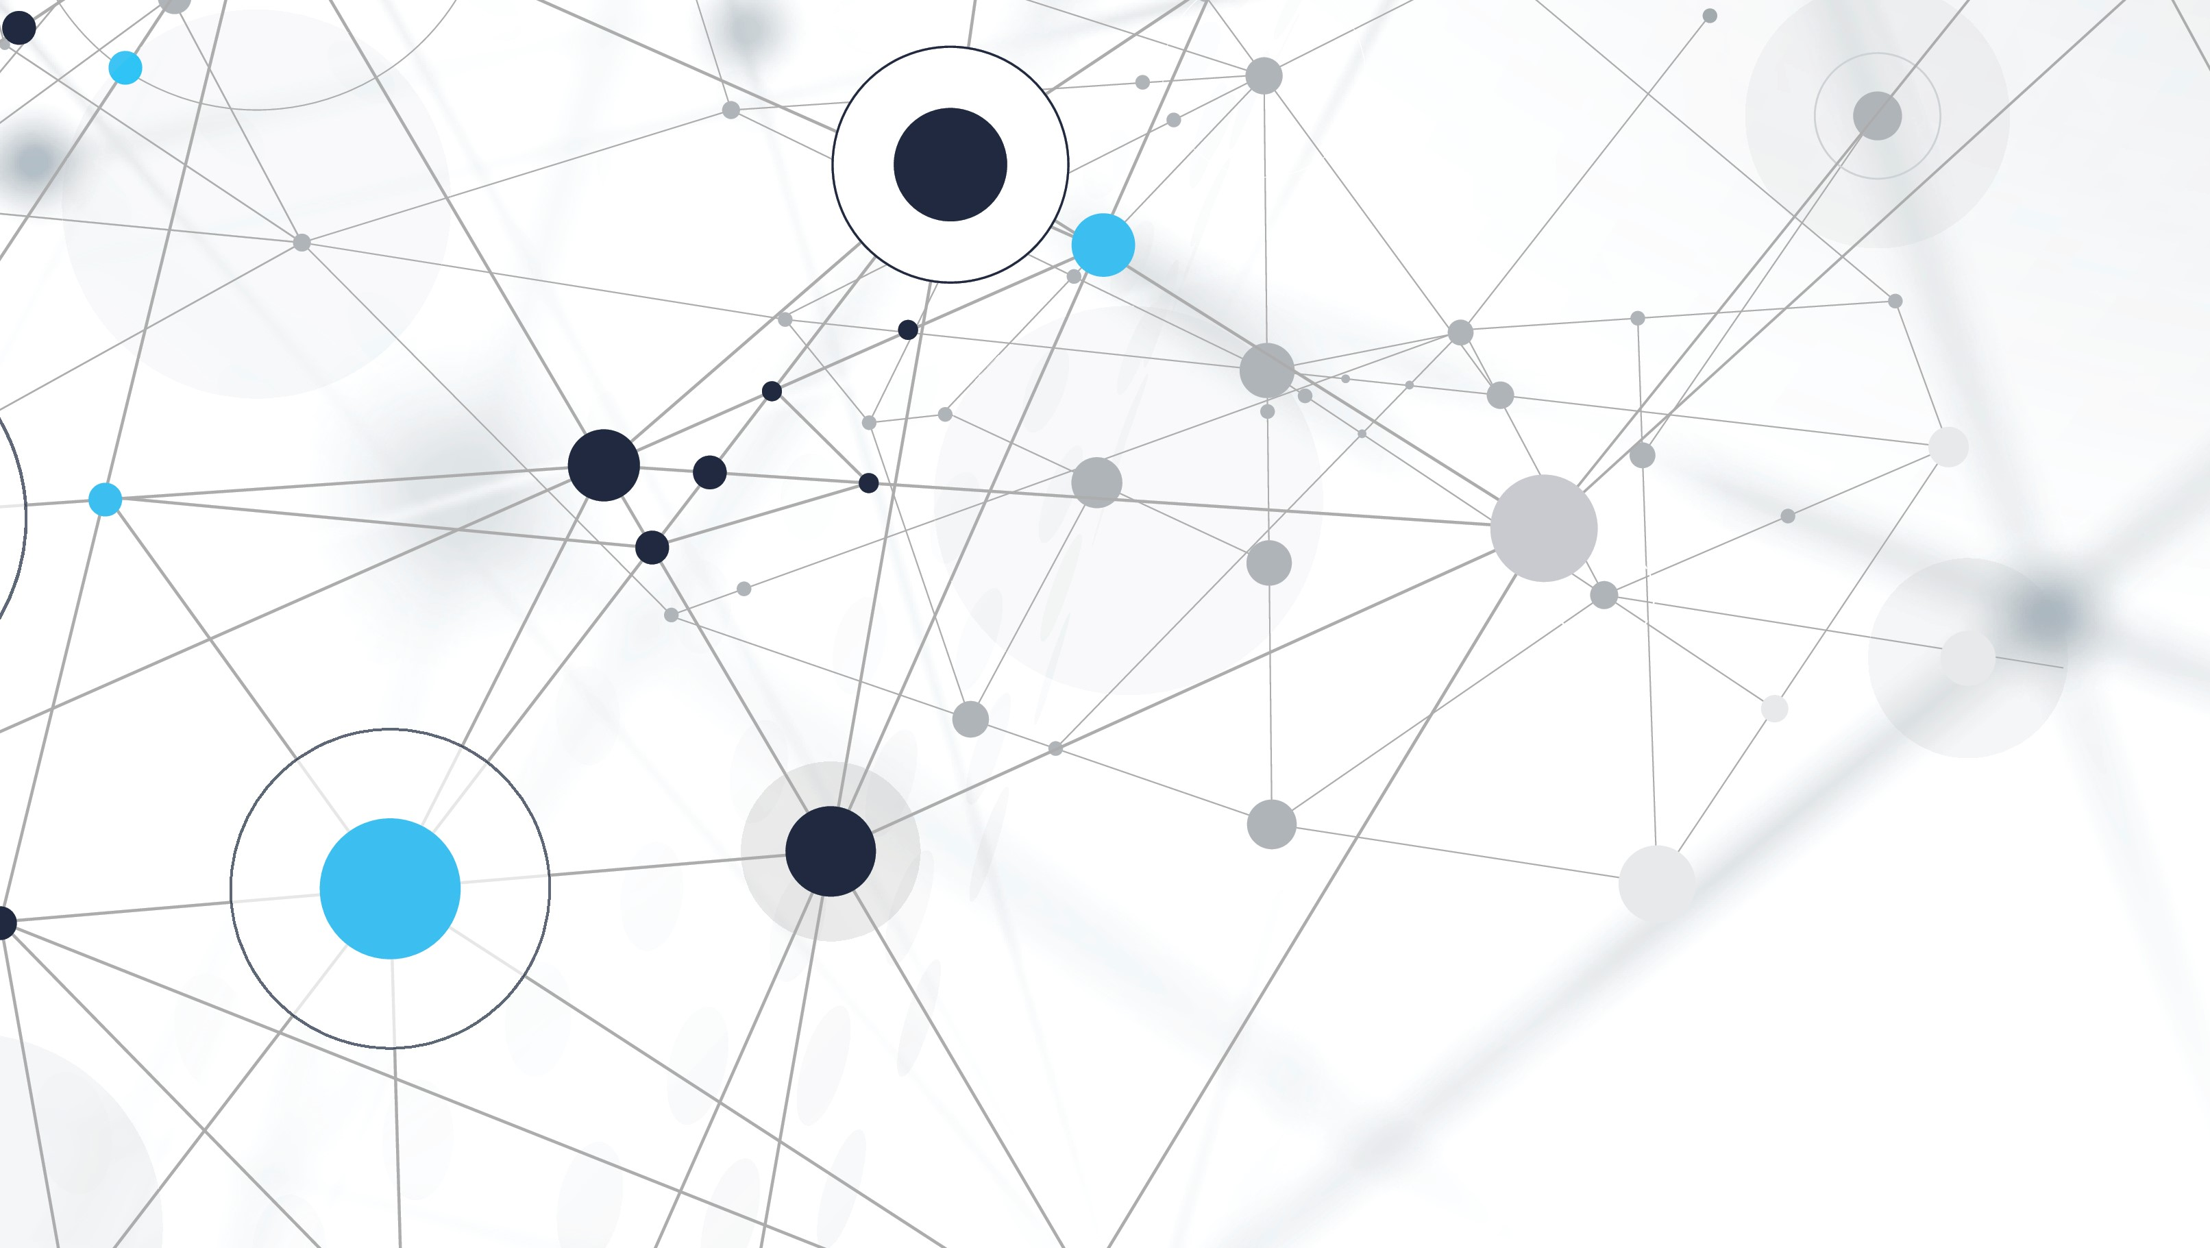
GENERATIVE NEUROLOGIST
DEEP LEARNING

Slide 2
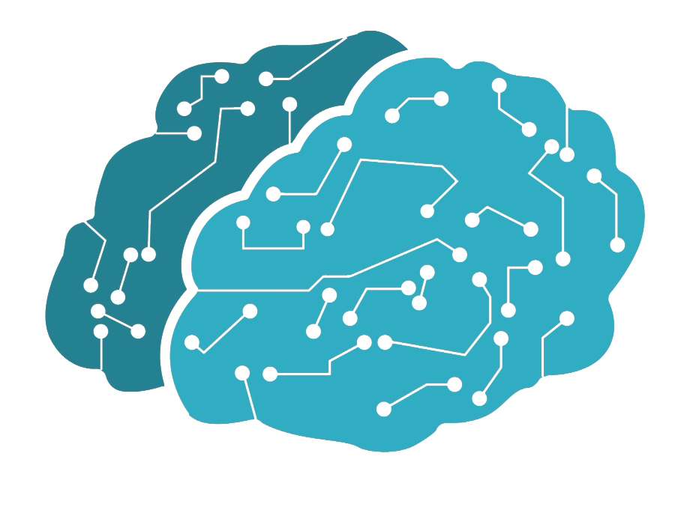
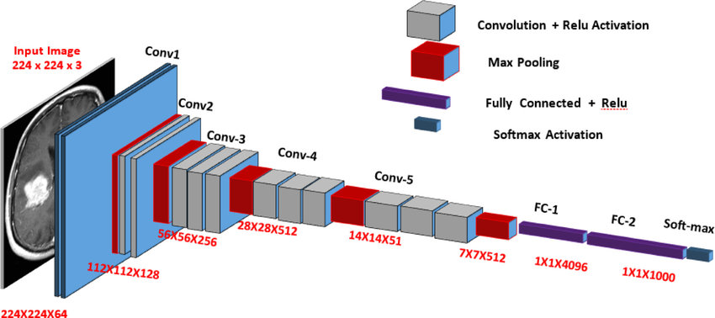

Generative Neurologist
1
VGG16 comprises 13 convolutional layers followed by fully connected layers. Each convolutional layer applies learnable filters to the input image, producing multiple feature maps capturing diverse aspects through element-wise multiplication and summation
Deep Architecture: VGG16, with its 16 layers, effectively learns complex features and captures intricate patterns and details in medical images.
Feature Extraction: VGG16's sequential convolutional and fully connected layers effectively extract informative features, including edge patterns, aiding in distinguishing different brain conditions or abnormalities
Sigmoid
2
Sigmoid

Slide 3
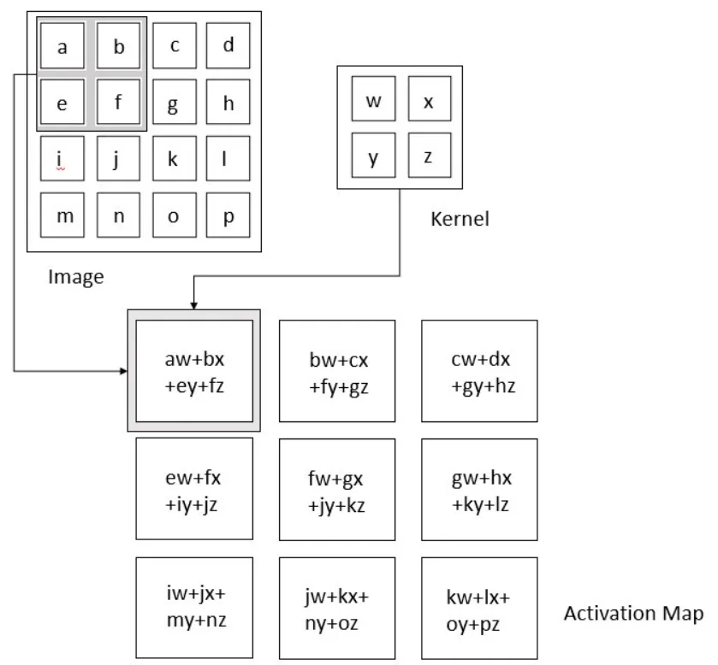
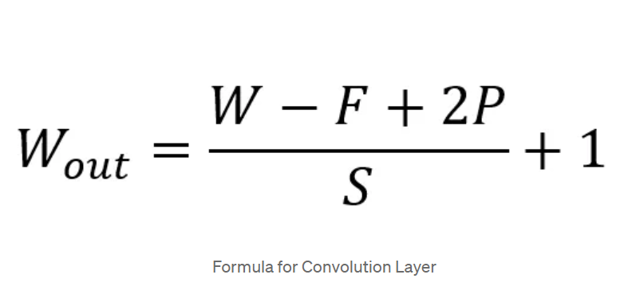
In a Conv2D layer, filters (or kernels) slide over the input data, performing a convolution operation. This involves multiplying the filter weights with the input data and summing the results, capturing local patterns or features in the input data such as edges, textures, and shapes etc.

Slide 4
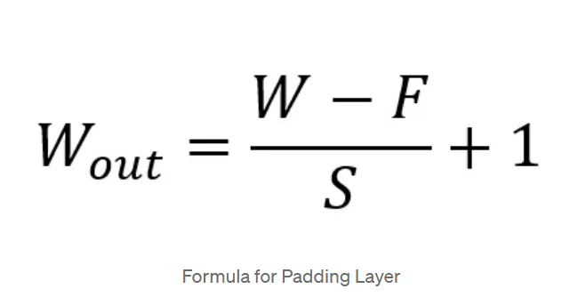
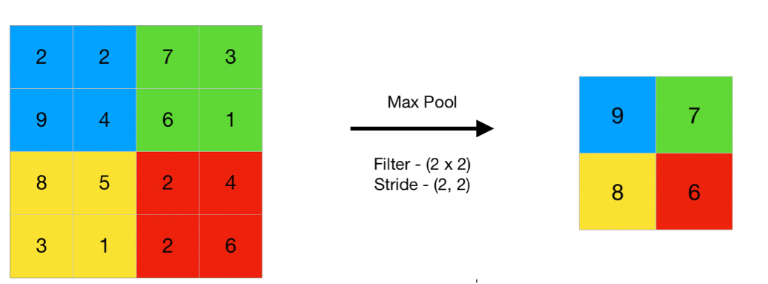
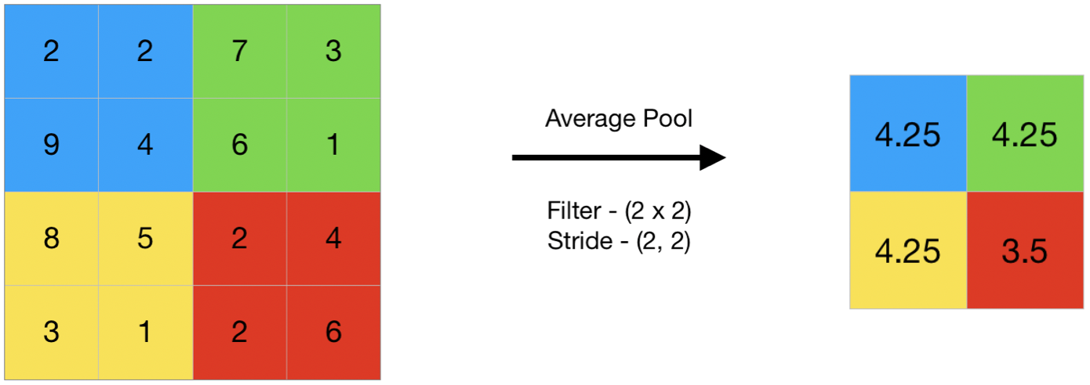
MaxPooling2D is a layer used in CNNs to downsample feature maps by reducing their dimensions. It works by keeping only the maximum value within a fixed window (such as 2x2 or 3x3) and discarding the rest. This process decreases the number of parameters and computational complexity in the network.

Slide 5
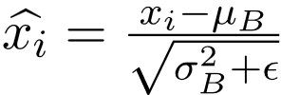
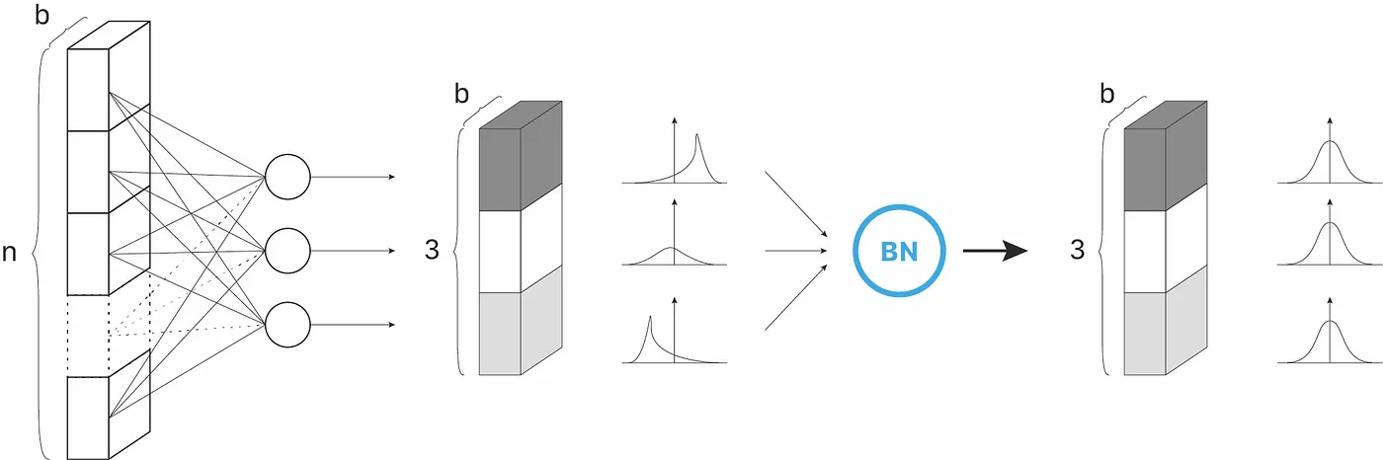
Batch normalization normalizes activation values or extracted features by standardizing them using their own mean and variance within each mini-batch during training.

Slide 6
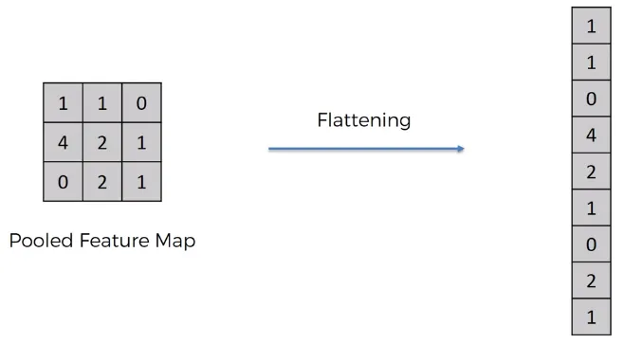
The flatten layer in neural networks, especially CNNs, converts multi-dimensional arrays (like the output from convolutional layers) into a one-dimensional vector. This prepares the data for fully connected layers.

Slide 7
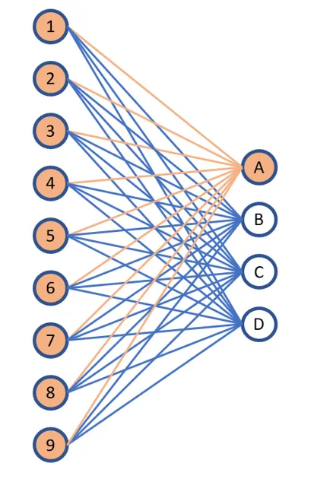
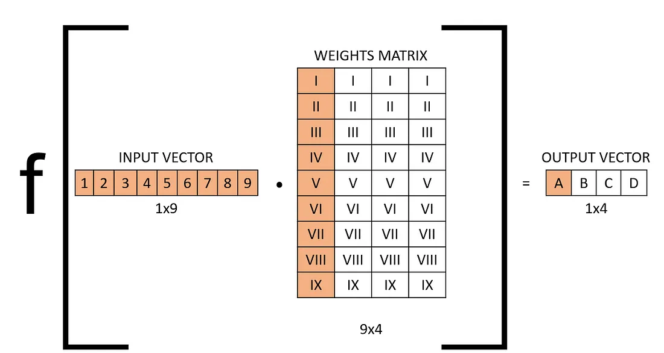
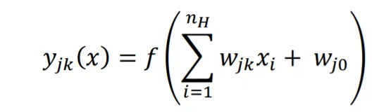
A fully connected layer or Dense layer is a type of neural network layer where each neuron is connected to every neuron in the preceding layer and every neuron in the subsequent layer. This layer is called "fully connected" because every input is connected to every output neuron, forming a complete connection matrix. Commonly used for feature aggregation and high level features extraction.
In fully connected layers, the neuron applies a linear transformation to the input vector through a weights matrix.

Slide 8
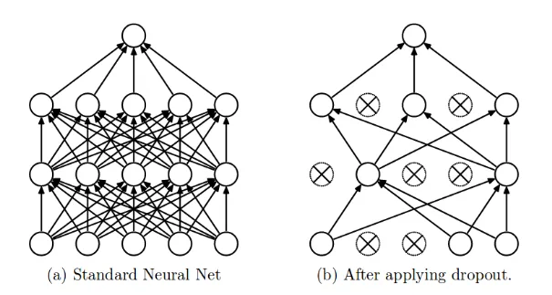
A dropout layer is a regularization technique used in neural networks to prevent overfitting. It works by randomly "dropping out" (i.e., setting to zero) a fraction of the neurons during each training iteration
Preventing Overfitting: Reducing the model's tendency to memorize the training data and improving its performance on new data

Slide 9
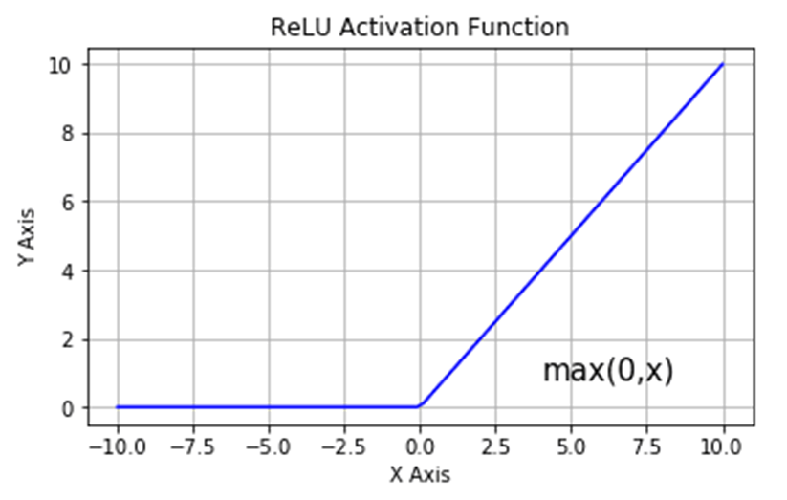
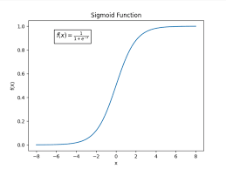
ReLU, or Rectified Linear Unit, is a simple effective activation function used in neural networks. It computes the output as the maximum between zero and the input value. Mathematically, ReLU(x) = max(0, x).
The sigmoid activation function, also known as the logistic function, is a type of activation function commonly used in neural networks, especially in the output layer for binary classification tasks. It squashes the output of a neuron to a range between 0 and 1, effectively converting any real-valued input into a probability value.

Slide 10
Forward Propagation : forward propagation enables the neural network to transform input data through its layers, incorporating weights, biases, and activation functions
Backward Propagation : backpropagation aims to minimize the cost function by adjusting network’s weights and biases. The level of adjustment is determined by the gradients of the cost function with respect to those parameters

Slide 11
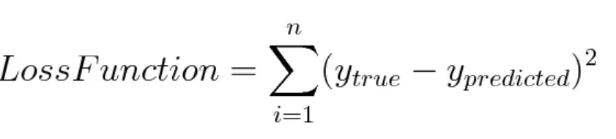
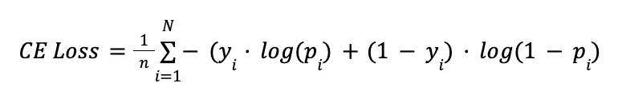
A loss function is a function that compares the target and predicted output values, measures how well the neural network models the training data.
Binary Cross-Entropy/Log Loss
This is the loss function used in binary classification models where the model takes in an input and has to classify it into one of two pre-set categories.

Slide 12
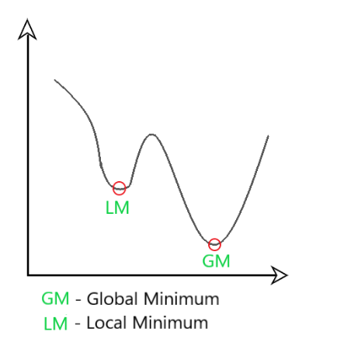
Gradient Descent
Gradient Descent is a fundamental optimization algorithm in machine learning used to minimize the cost or loss function during model training.
It iteratively adjusts model parameters by moving in the direction of the steepest decrease in the cost function.
The algorithm calculates gradients, representing the partial derivatives of the cost function concerning each parameter.

Slide 13
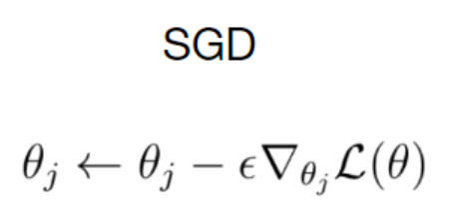
Stochastic Gradient Descent (SGD)
In SGD, instead of using the entire dataset for each iteration, only a single random training example (or a small batch) is selected to calculate the gradient and update the model parameters. This random selection introduces randomness into the optimization process, hence the term “stochastic” in stochastic Gradient Descent

Slide 14

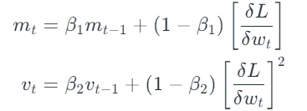

An optimizer is an algorithm that adjusts the parameters of a model to minimize the error between predicted and actual outcomes
Adam optimizer :
Essentially Adam is a combination of Momentum and RMSProp. It has reduced oscillation, a more smoothed path, and adaptive learning rate capabilities
V_{t} = sum of square of past gradients. [i.e sum(∂L/∂Wt-1)]
m_{t} = aggregate of gradients at time t [current]
β₁ & β₂ = decay rates of average of gradients in the above two methods. (β₁ = 0.9 & β₂ = 0.999

Slide 15
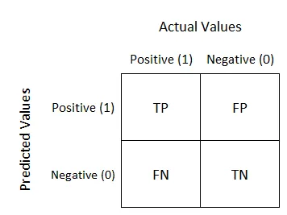



Confusion Matrix
it is a performance measurement for machine learning classification problem where output can be two or more classes. It is a table with 4 different combinations of predicted and actual values.

Slide 16
THANK YOU

